Slide 1
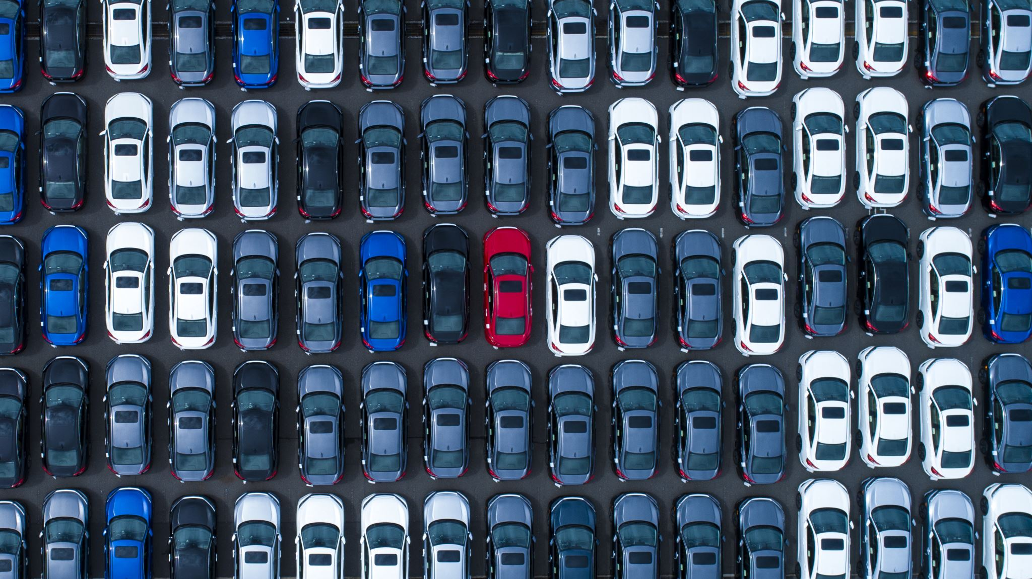
“A Car Rental Portal” A Web-Based Portal
Member: Manish Neupane

Slide 2
PresentationOutline
1. Introduction
2. Tools and Technology Used Within the Project
3. Physical DFD and Flowchart of Project
4. Database Design
5. Project Demo Live

Slide 3
INTRODUCTION
The Car Rental Portal is an online system developed to make it easier for customers to rent cars. Through this platform, customers can view available cars, register on the website, and book a car they need.
In the current manual system, managing car bookings and availability takes a lot of effort and time. Finding which cars are available for rent can be challenging, and maintaining booking records is even harder. This project aims to automate these tasks, making car rental management simple and efficient.

Slide 4
Tools and Technology used within the project
1. Programming Languages
PHP: Used for developing the backend with MySQL.
JavaScript: Used for building and logic in frontend
HTML & CSS: Used for structuring and styling the frontend.
2. Database and Tools
MySQL: Serves as the primary database for storing user data, Cars, and related information.
VS Code: Used for writing codes and debugging.

Slide 5
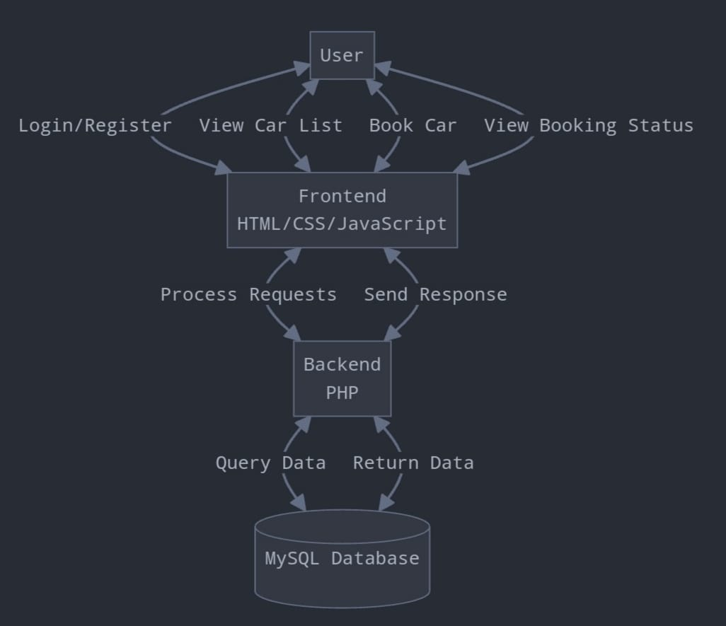
Physical DFD
A Physical DFD shows how data flows in a system.
It focuses on the physical implementation, such as hardware, software, databases, and user interactions.

Slide 6
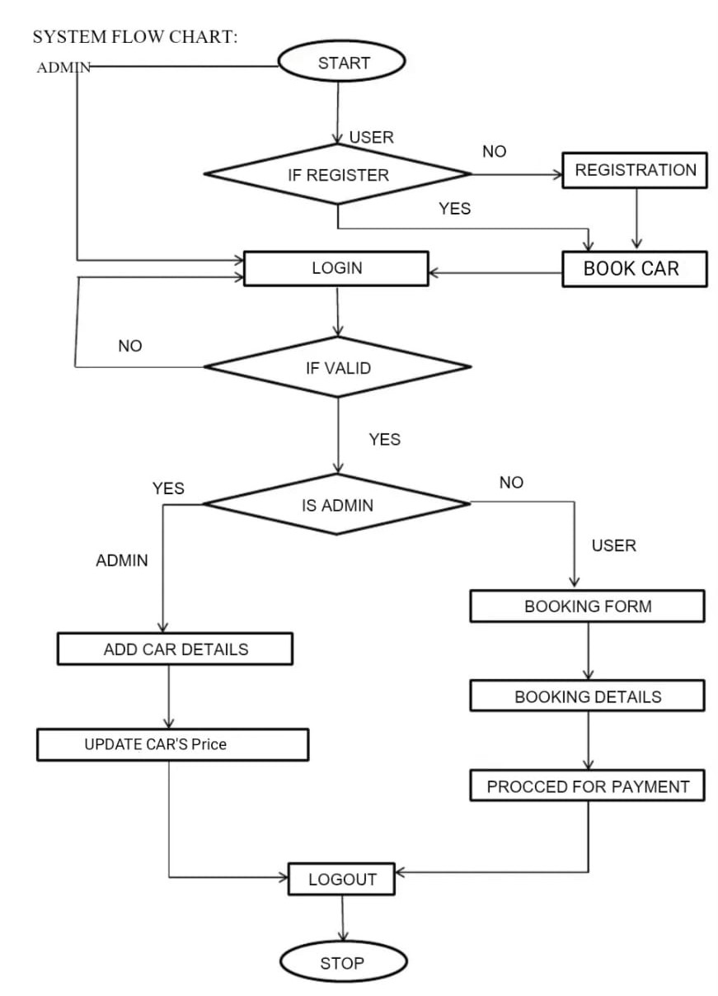
Flowchart
It is a visual representation of the sequence of steps and decisions needed to perform a process.

Slide 7
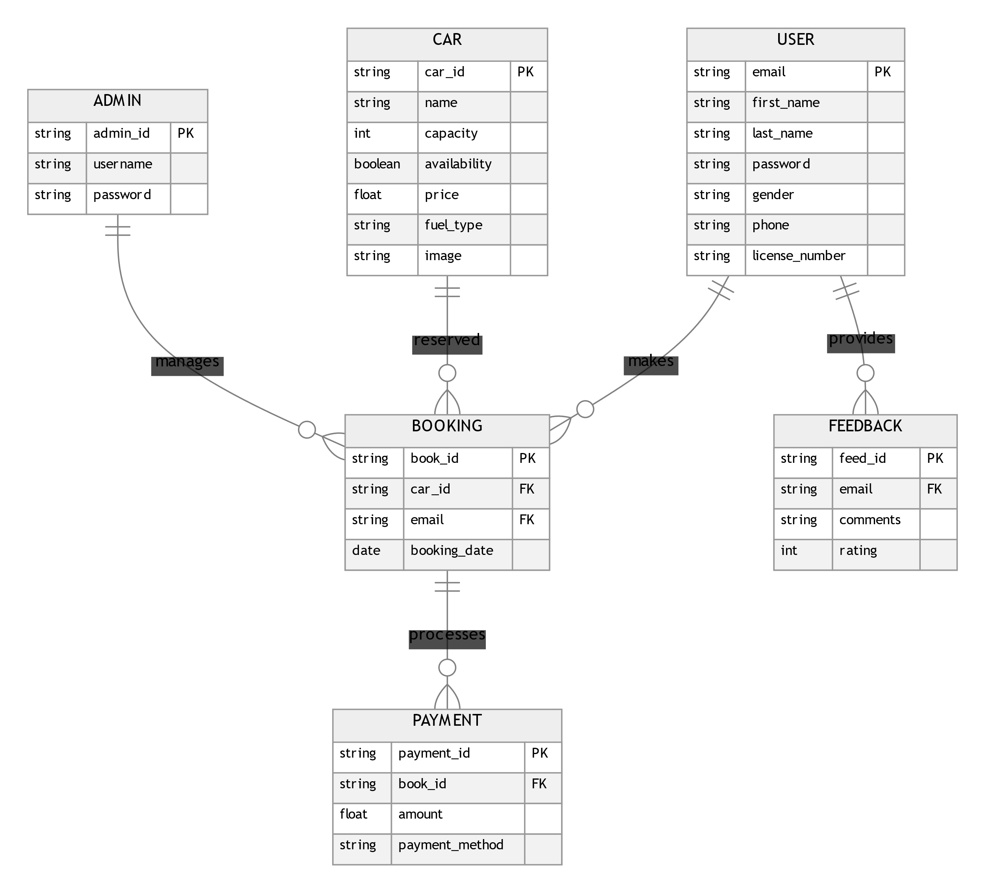
Database Design
It tells us about the structural view of the database.
It gives us an overall description of the database.

Slide 8
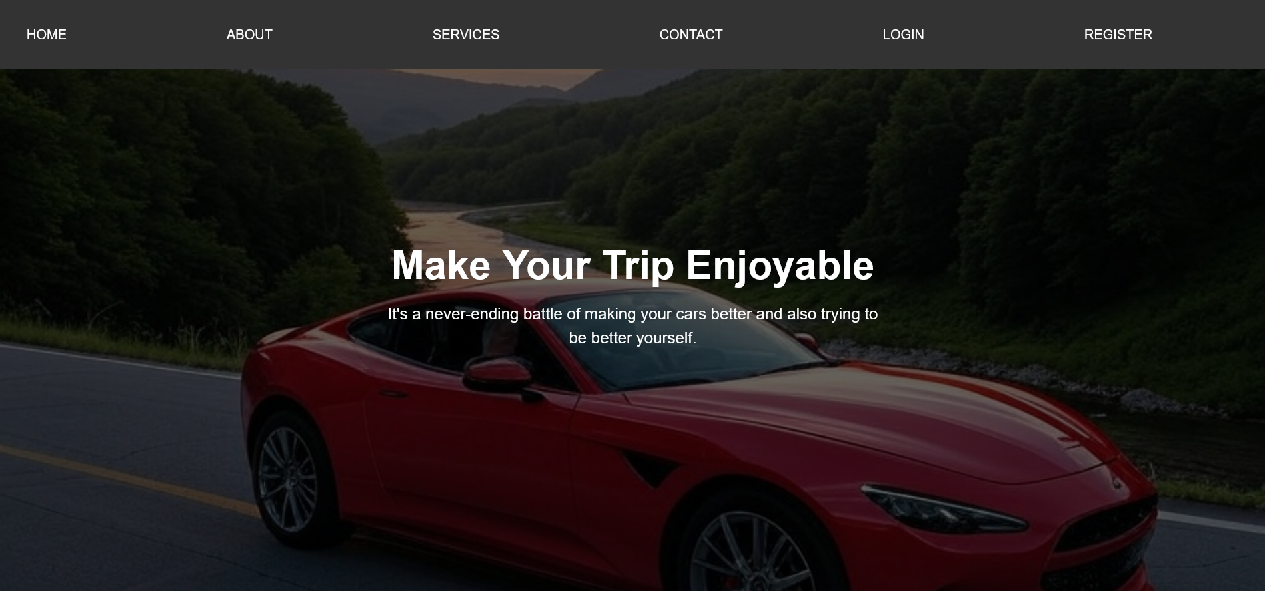
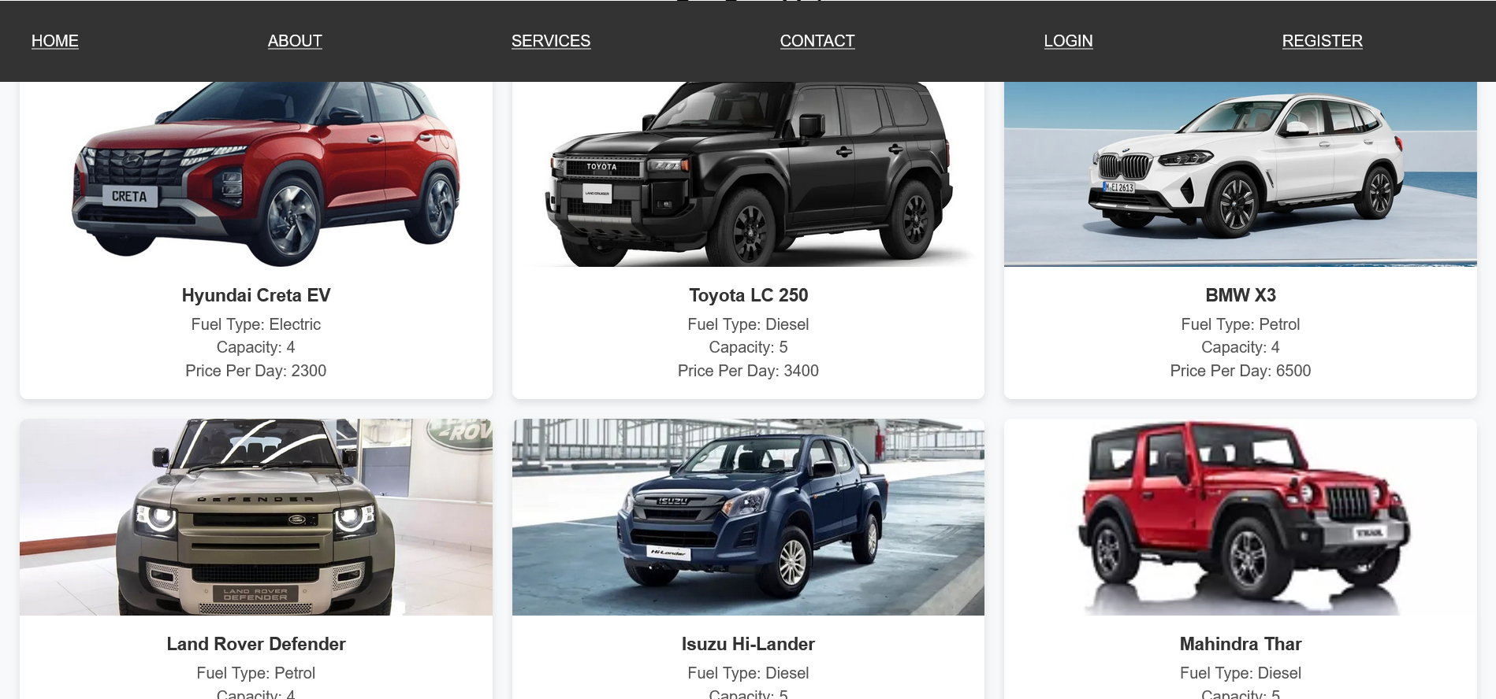
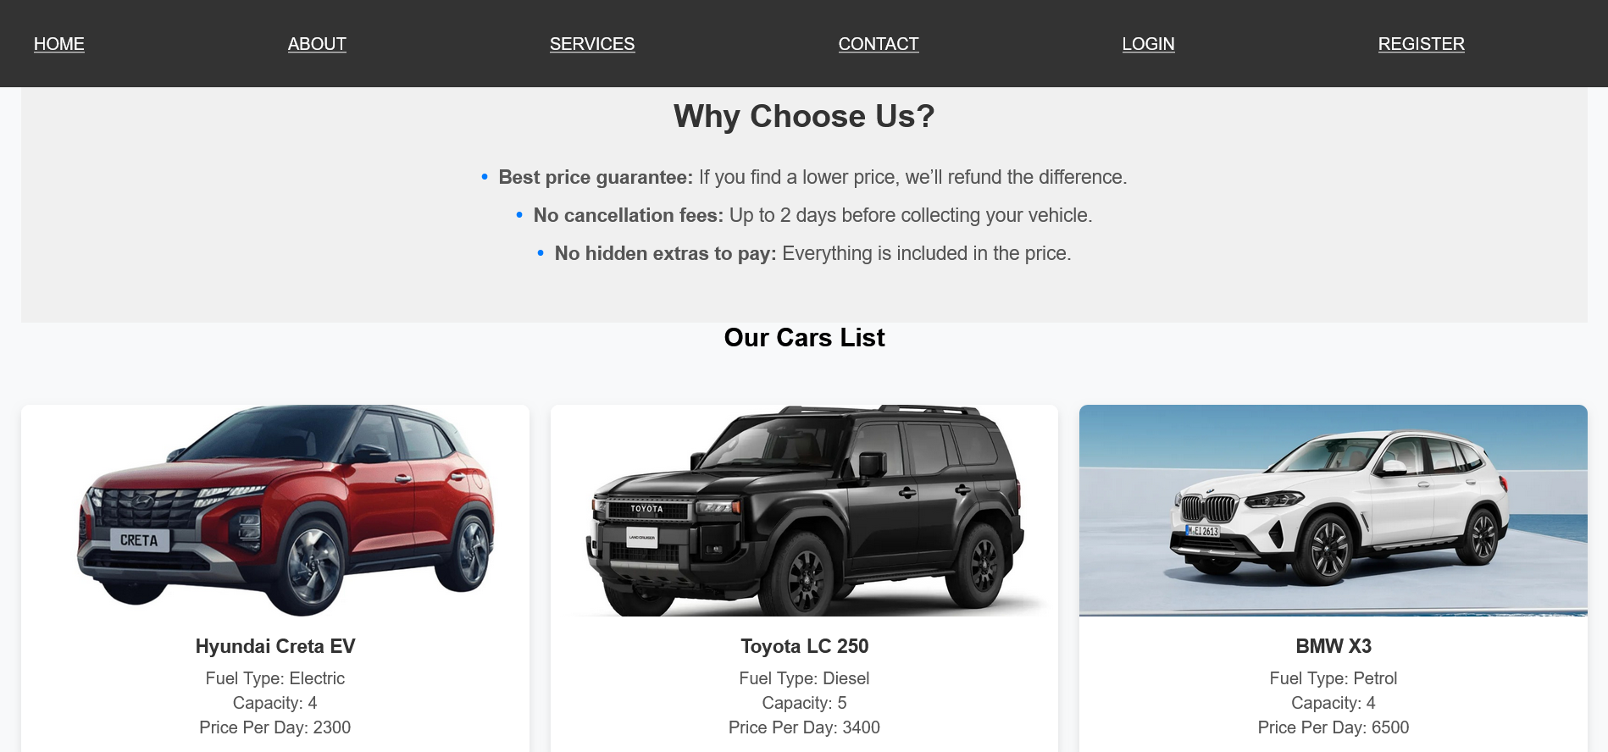
Project Demo Live

Slide 9
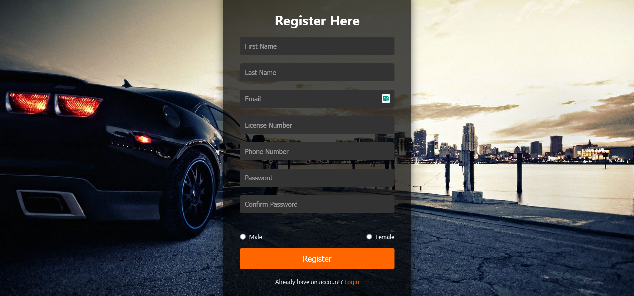
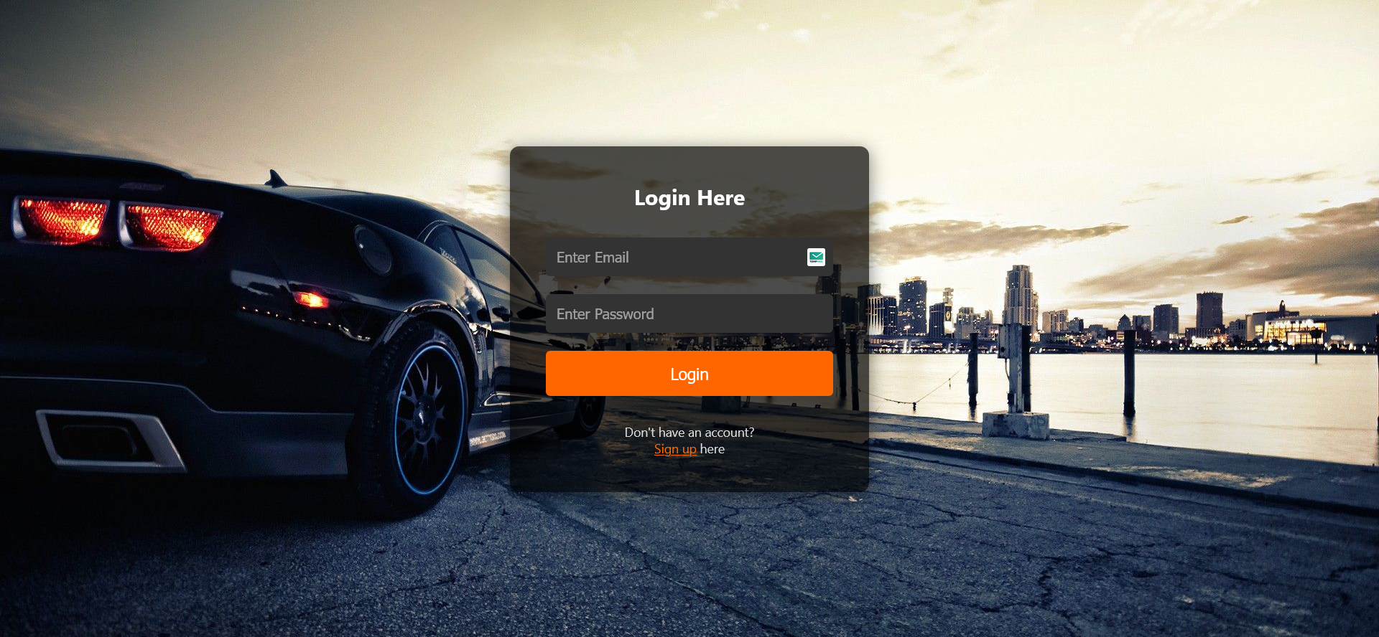

Slide 10
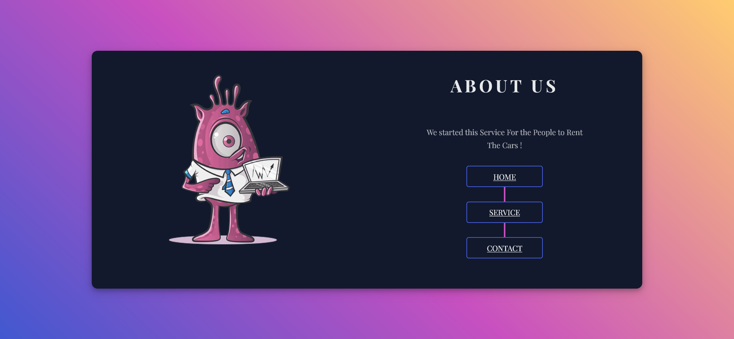
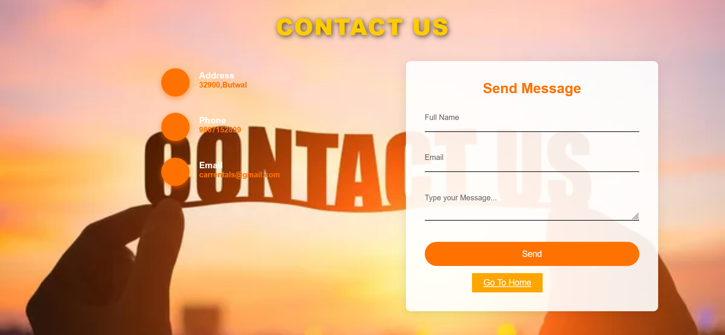

Slide 11
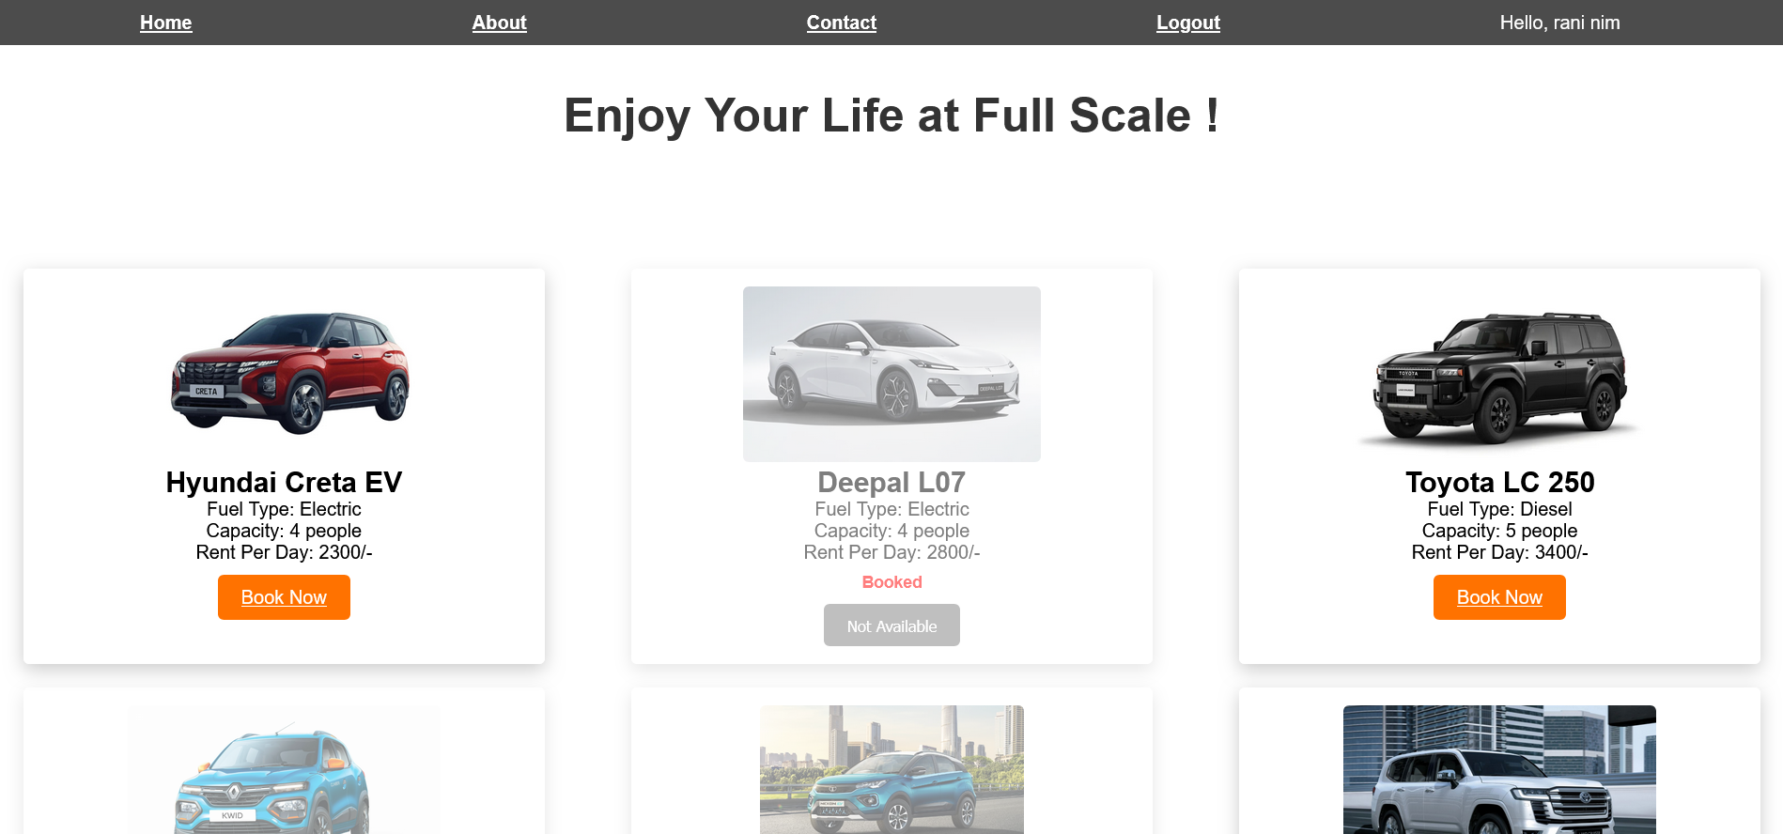
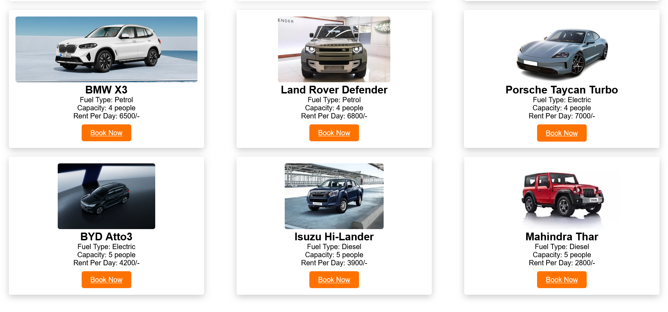

Slide 12
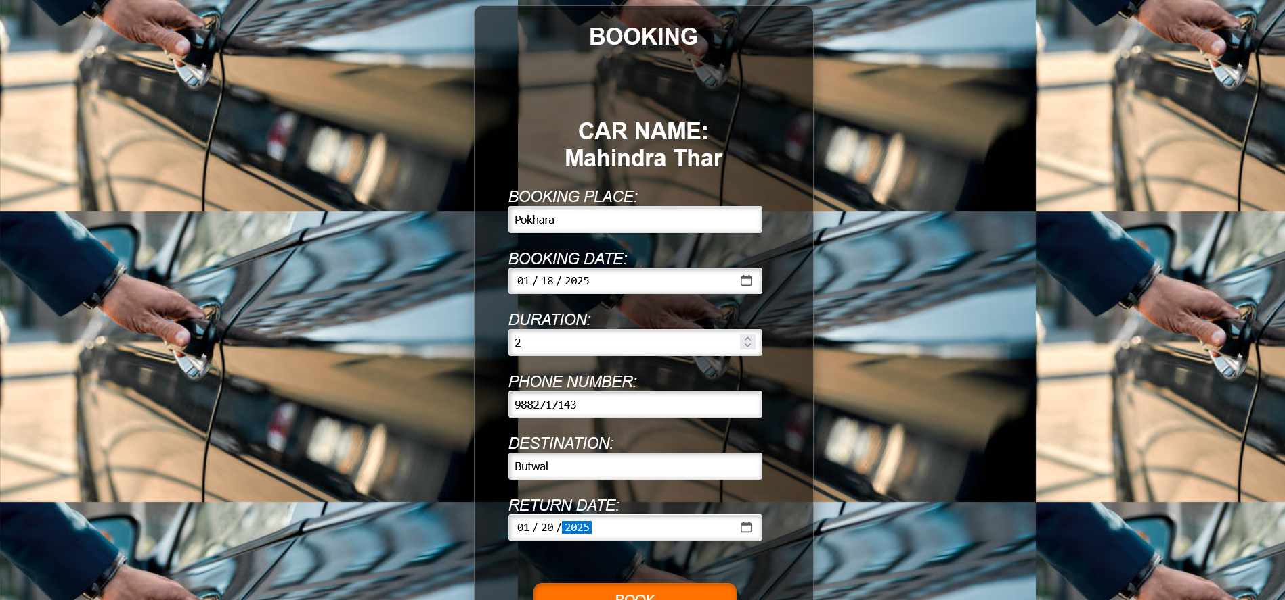
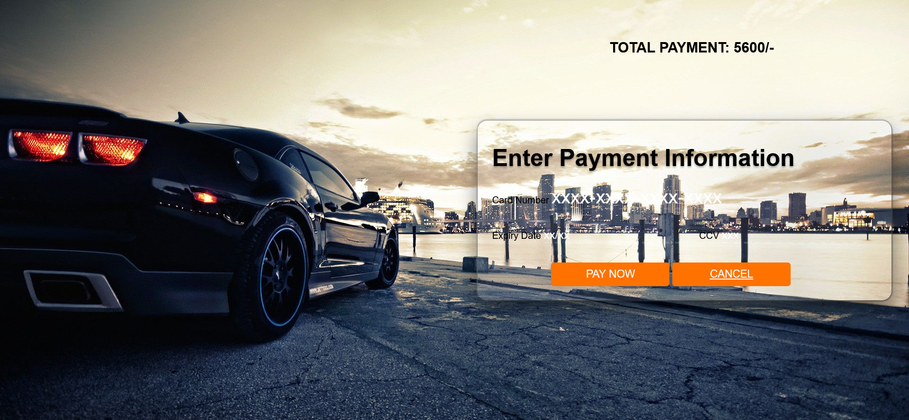

Slide 13
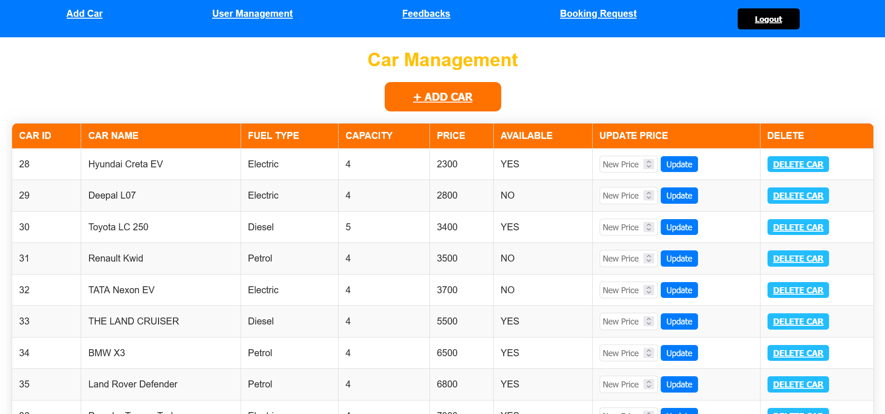
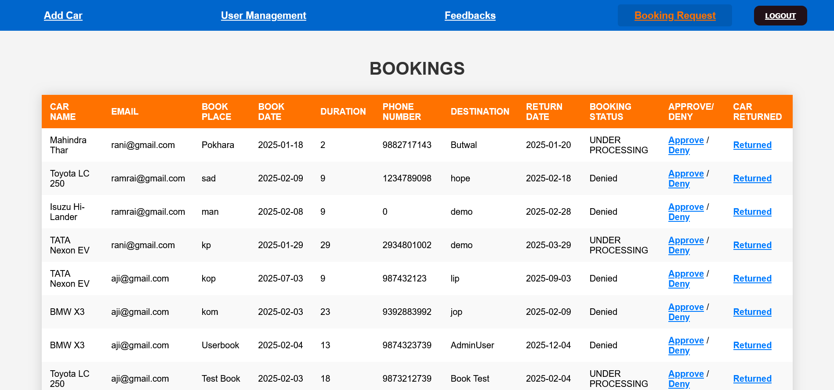

Slide 14
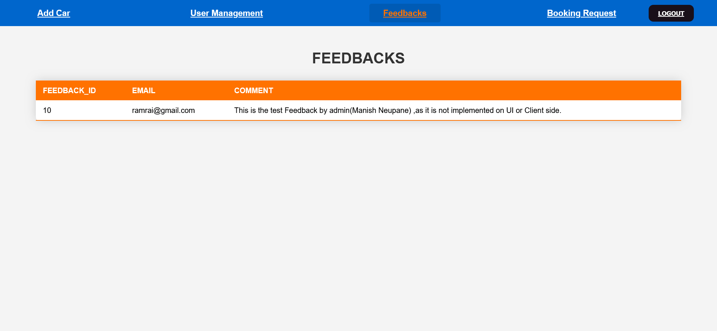
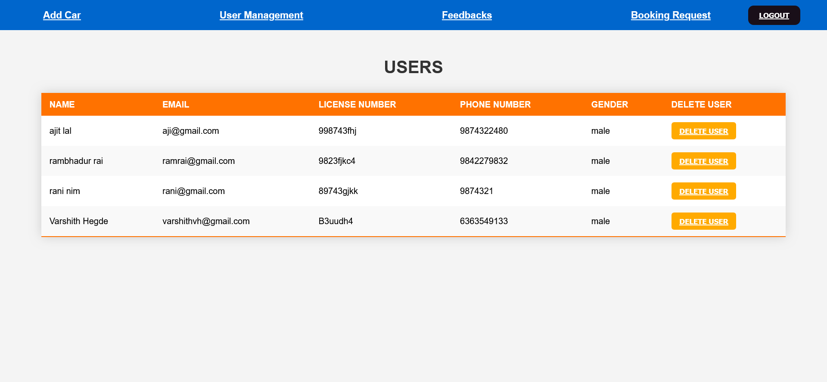

Slide 15

Thank you

